Slide 1

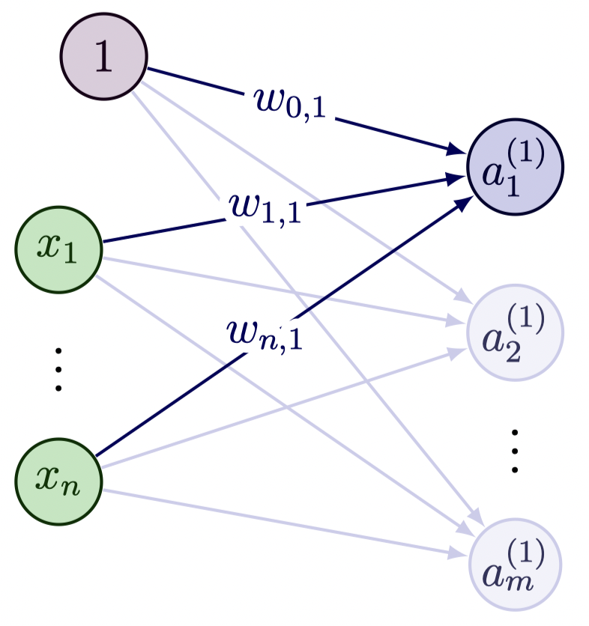
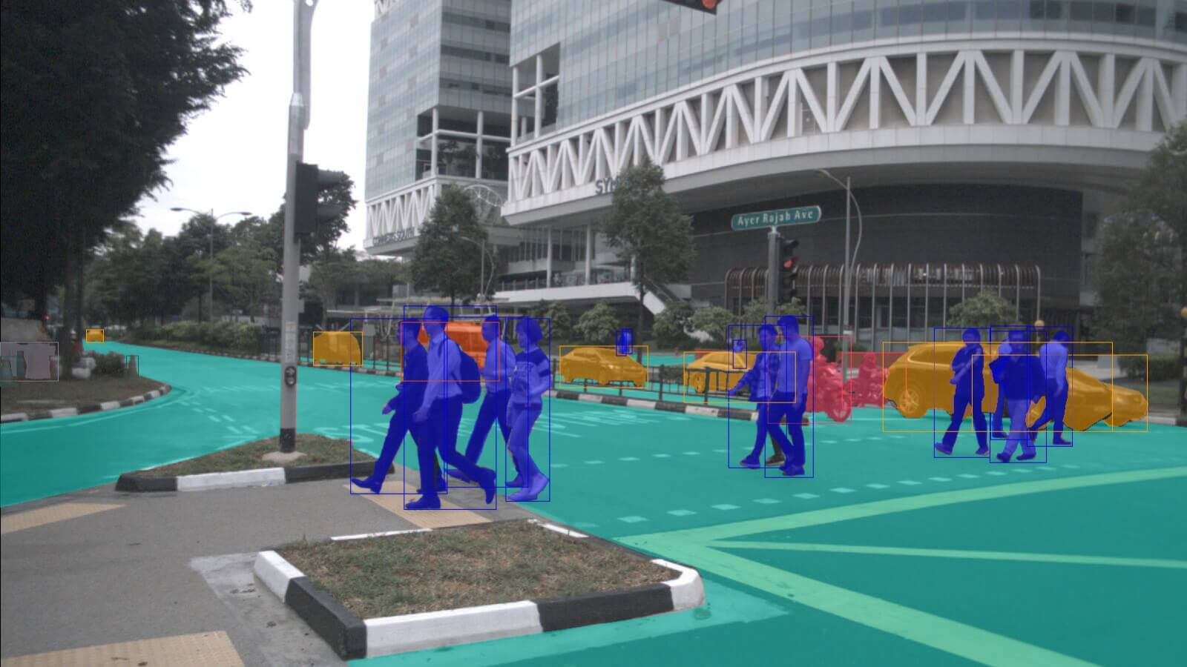
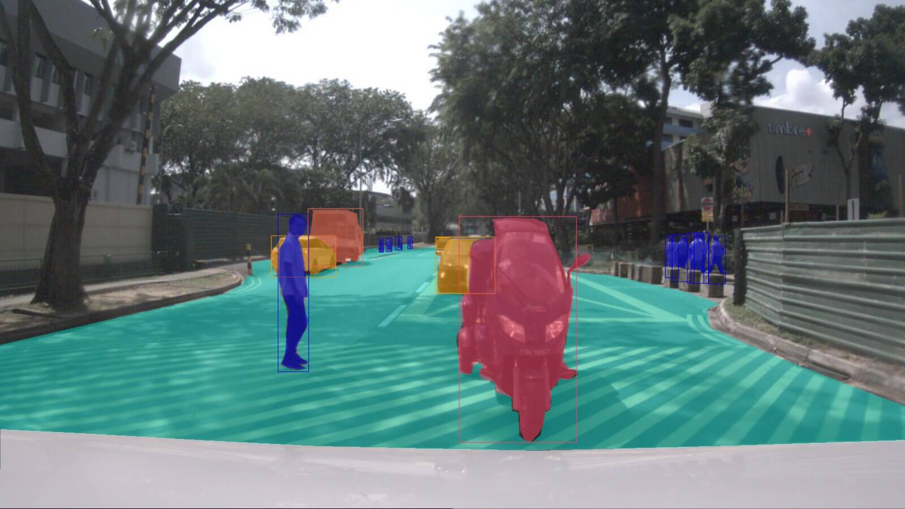
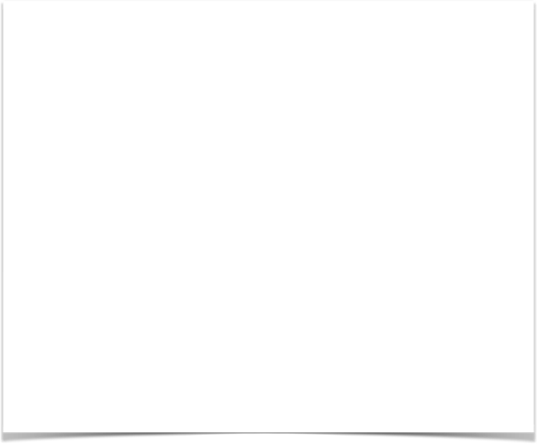
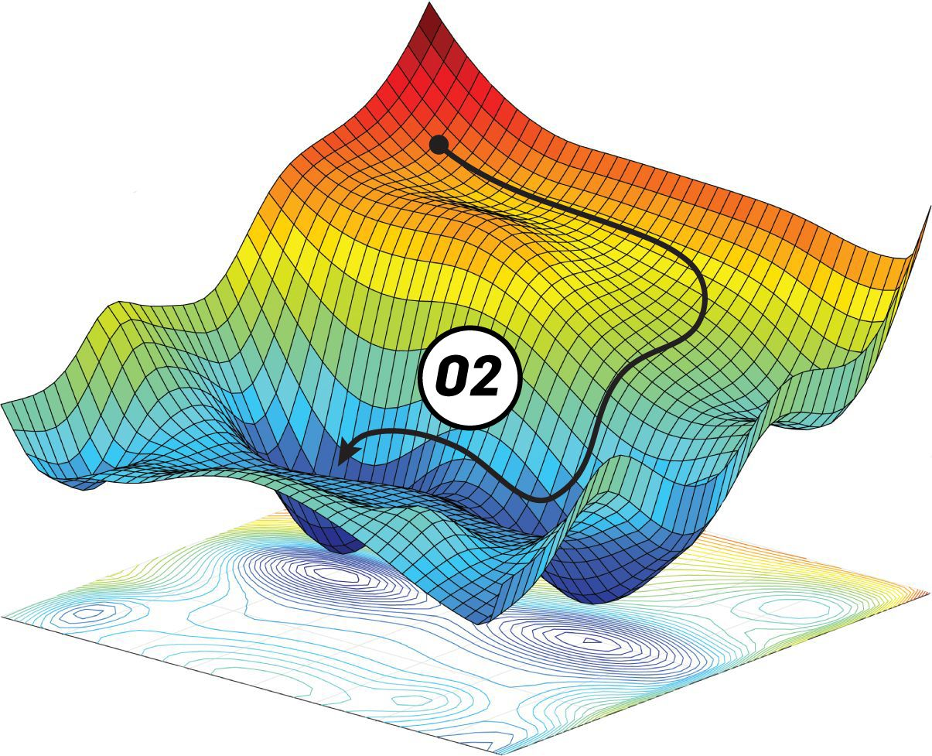
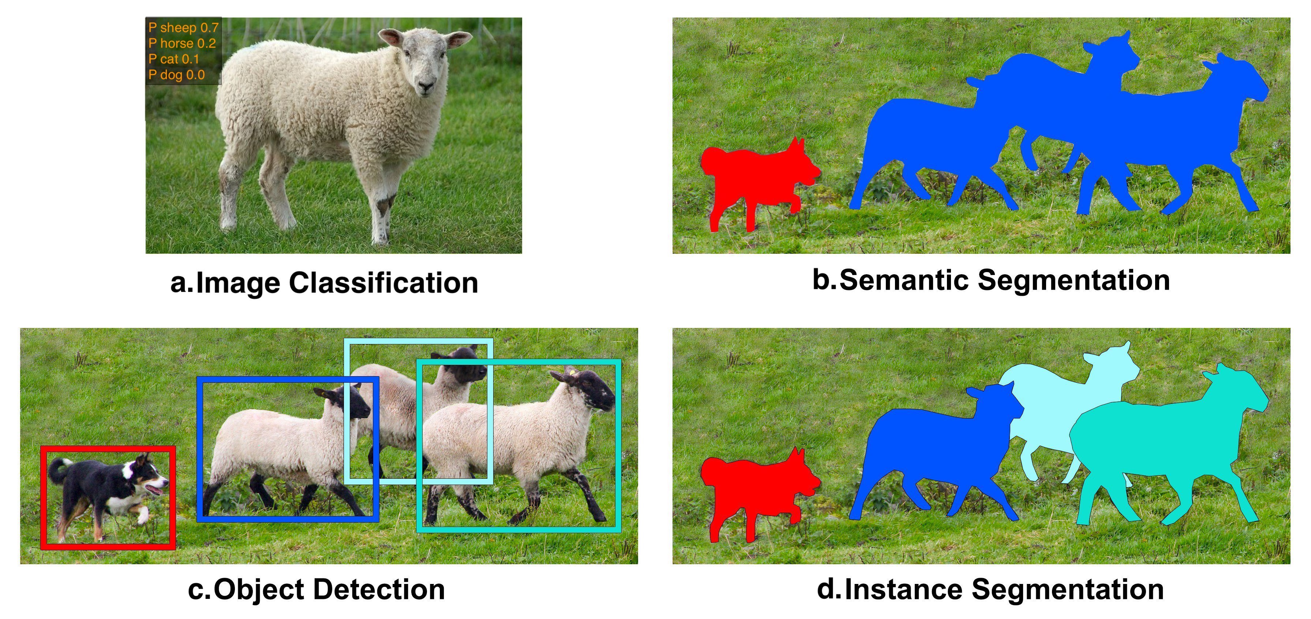
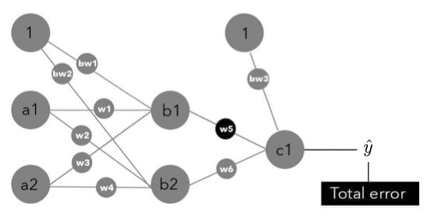
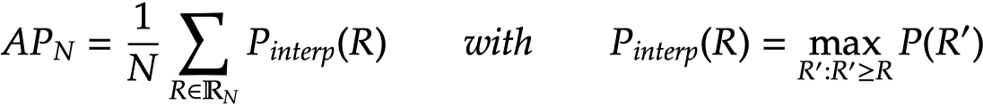
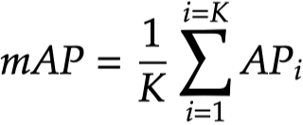
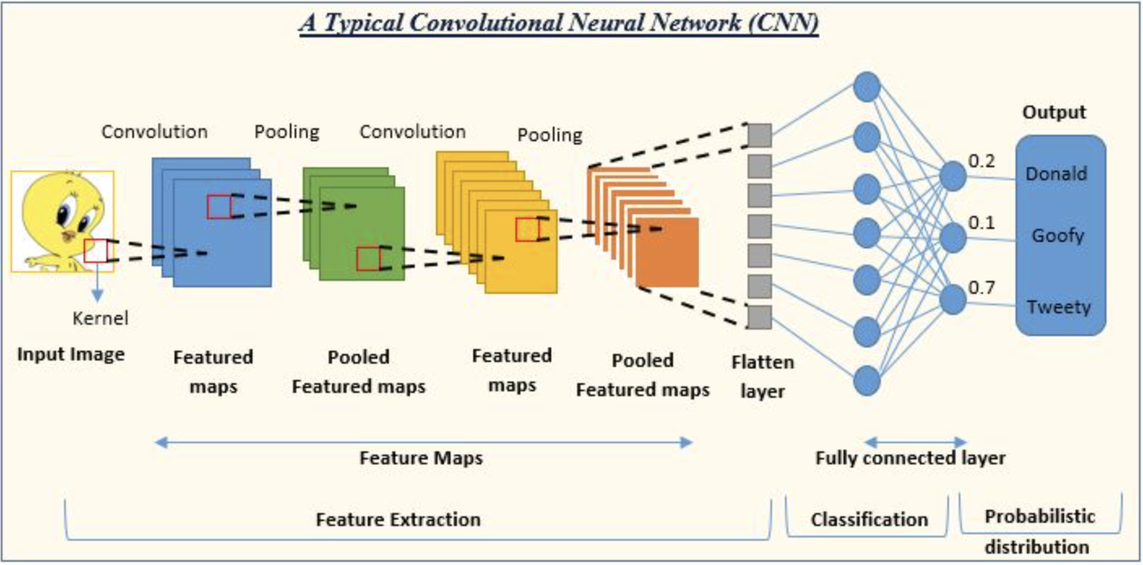
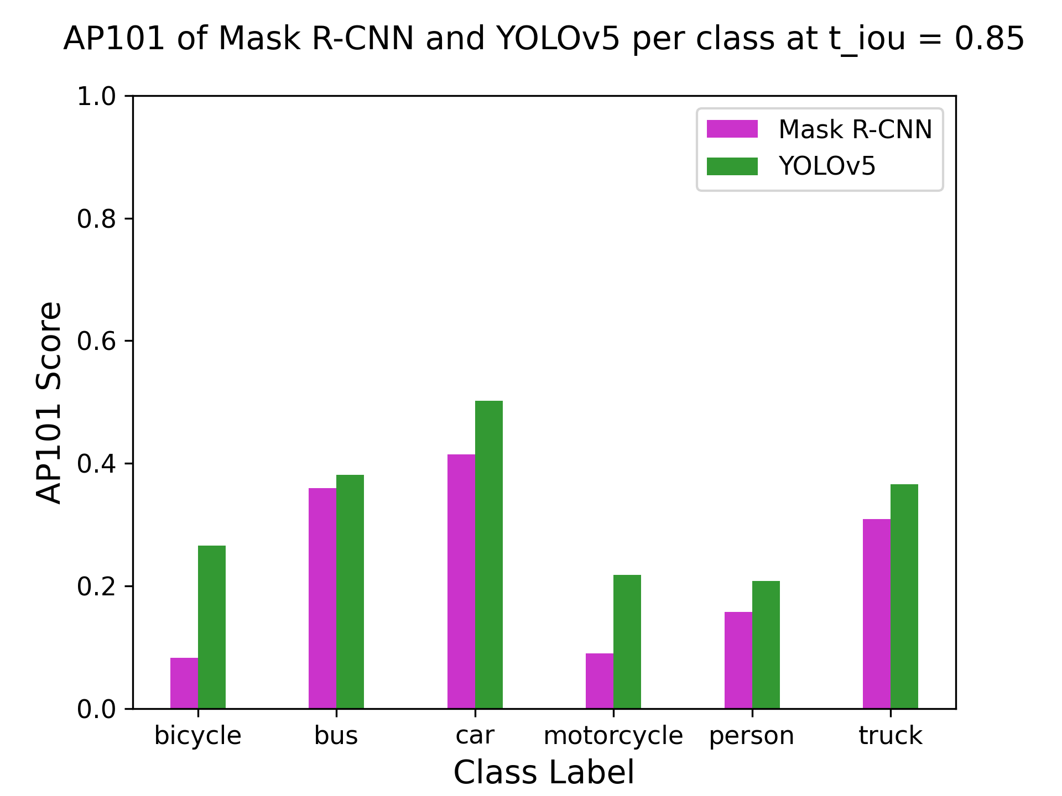
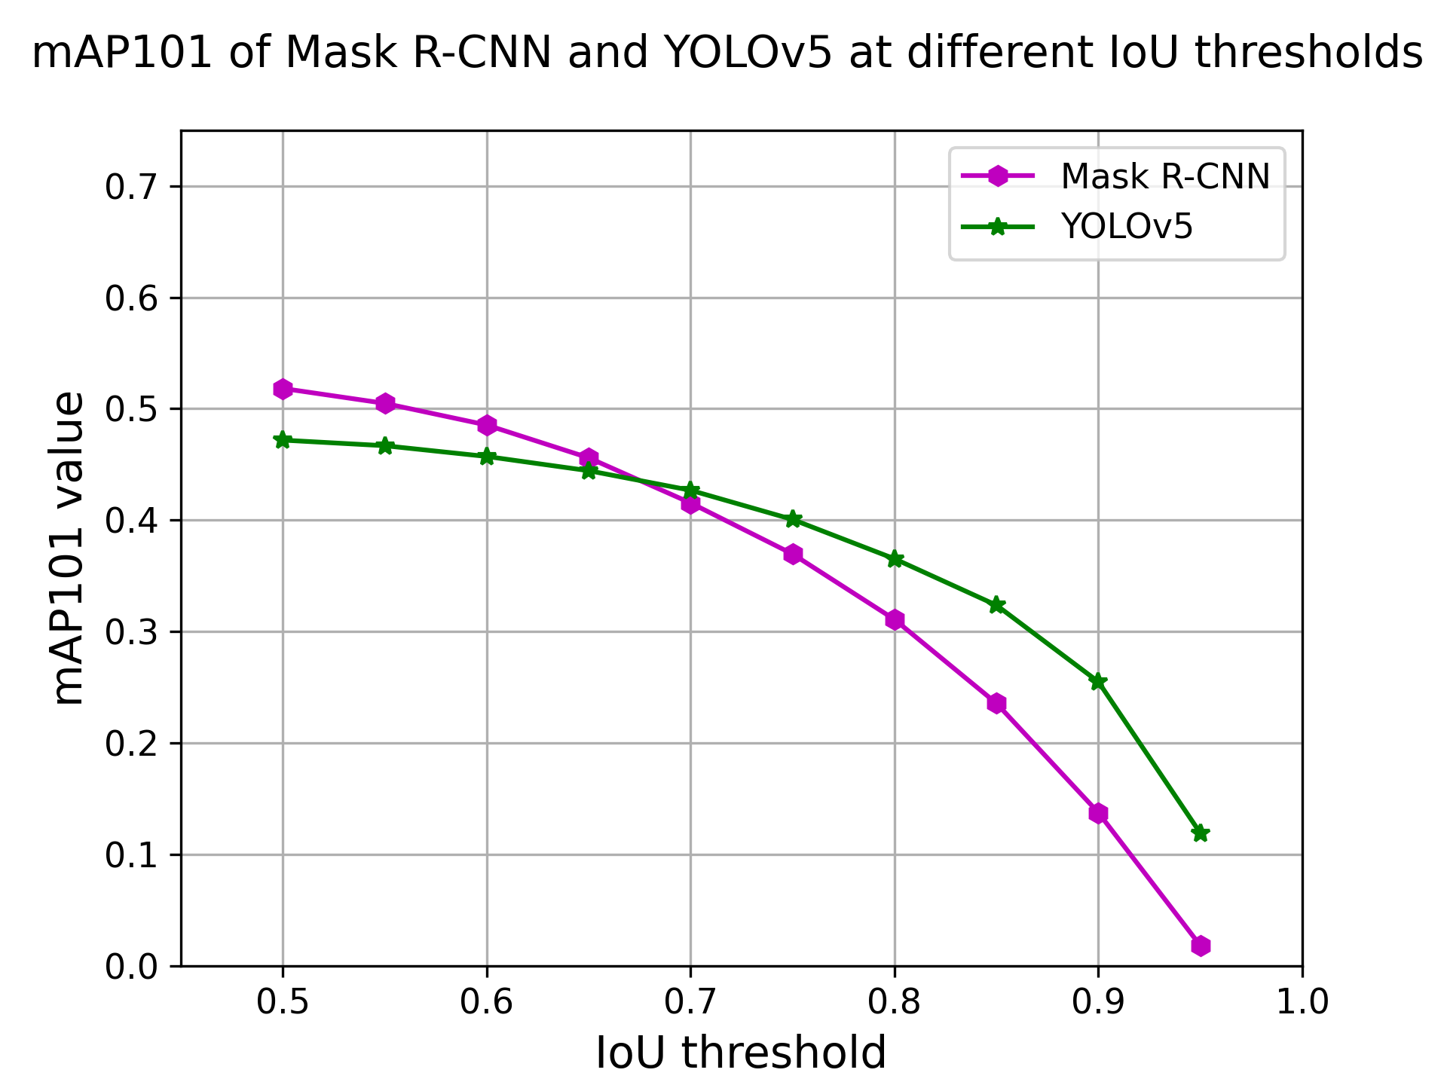
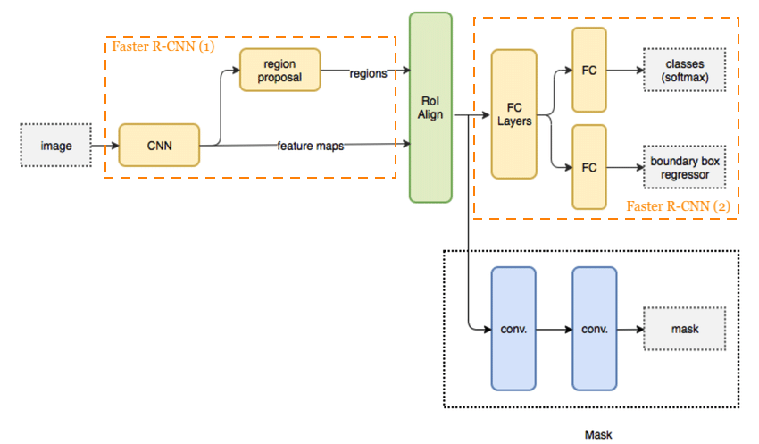
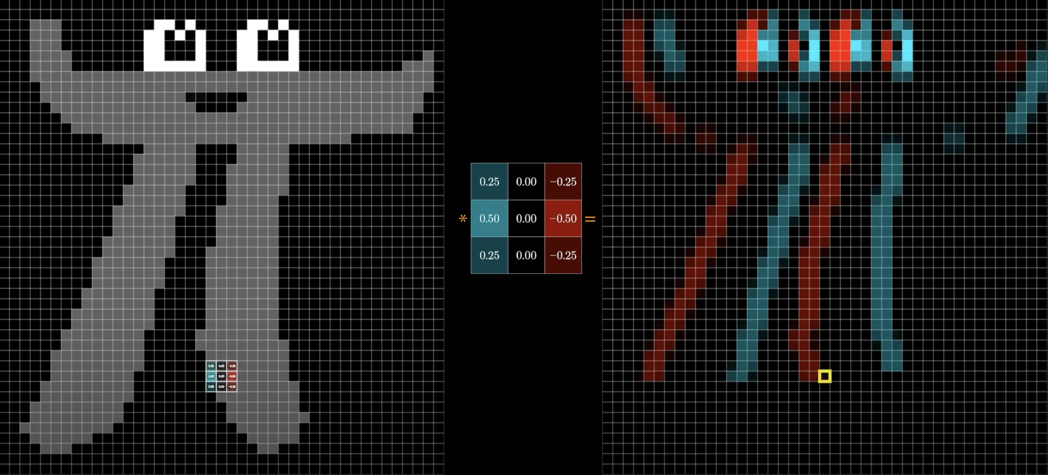
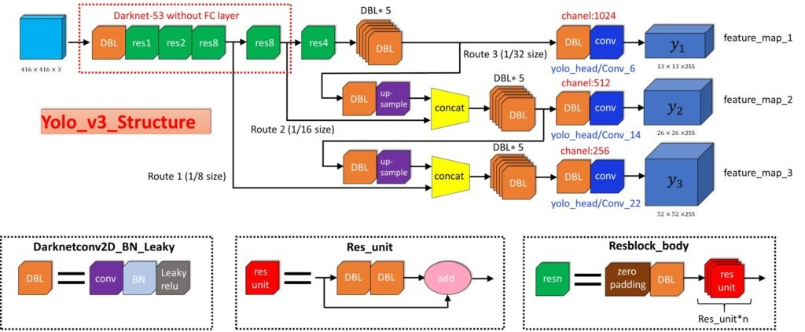
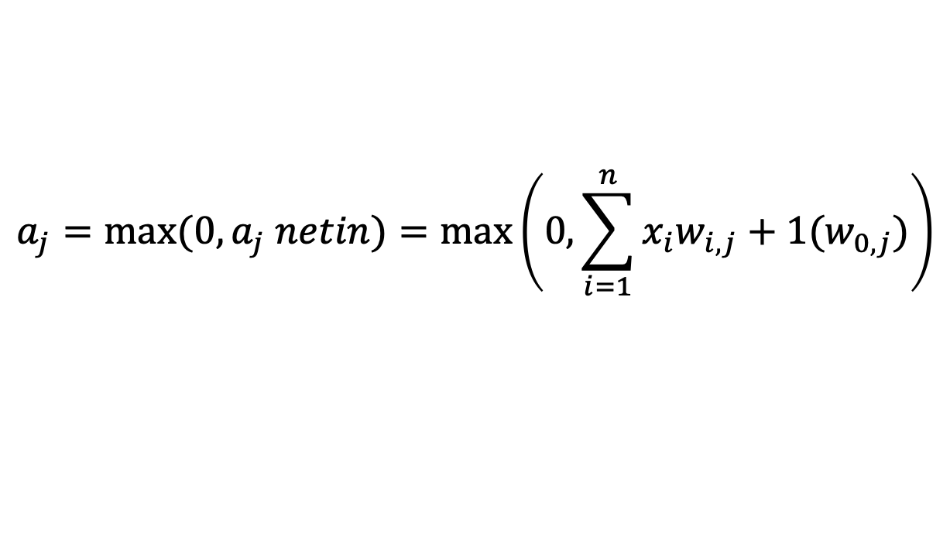
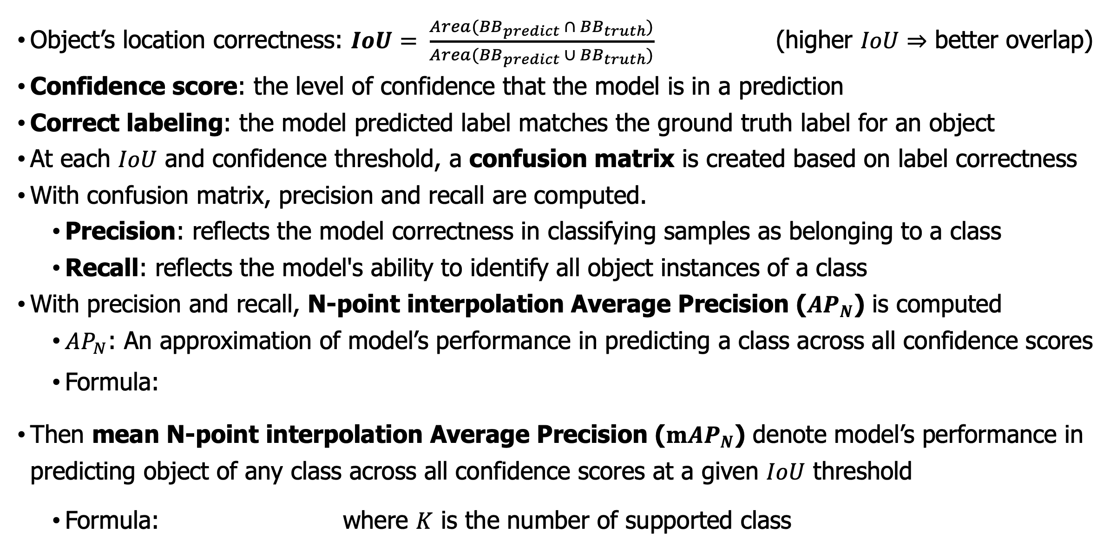
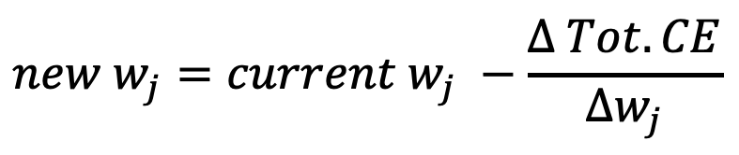
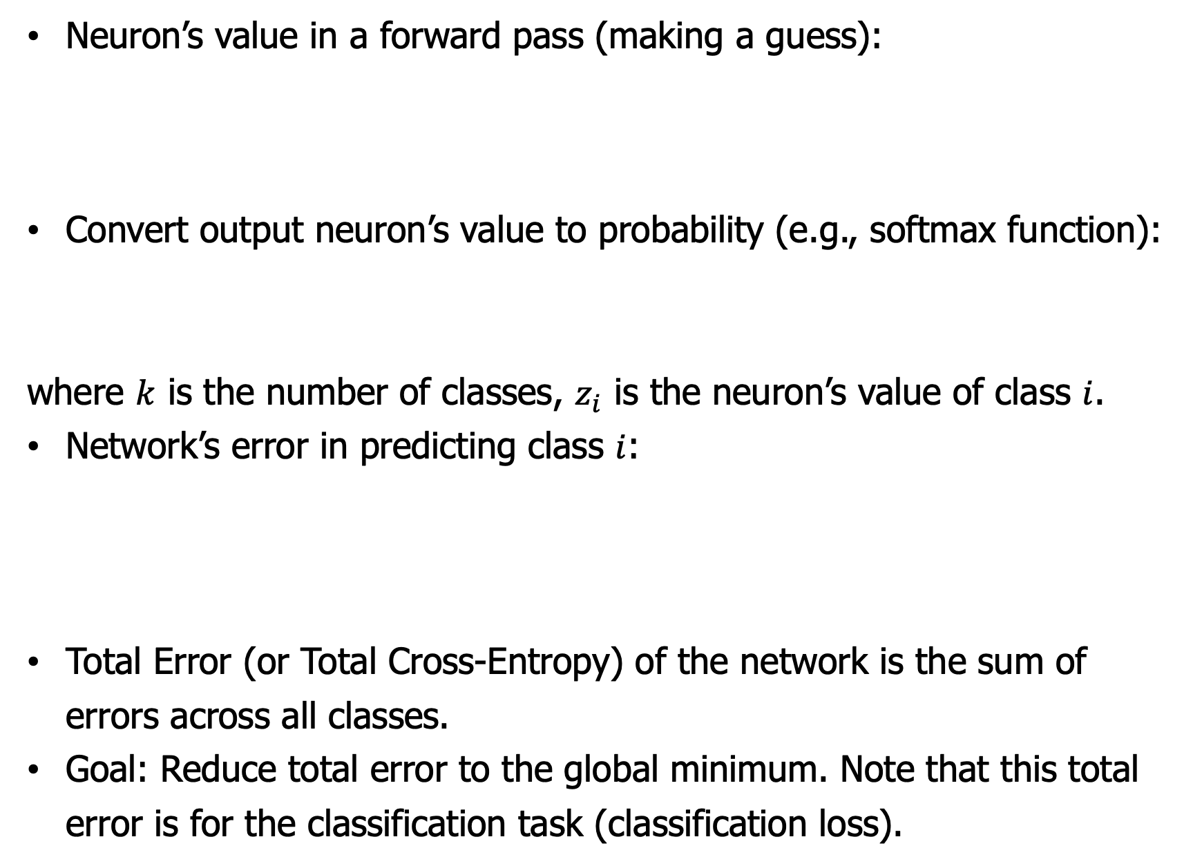
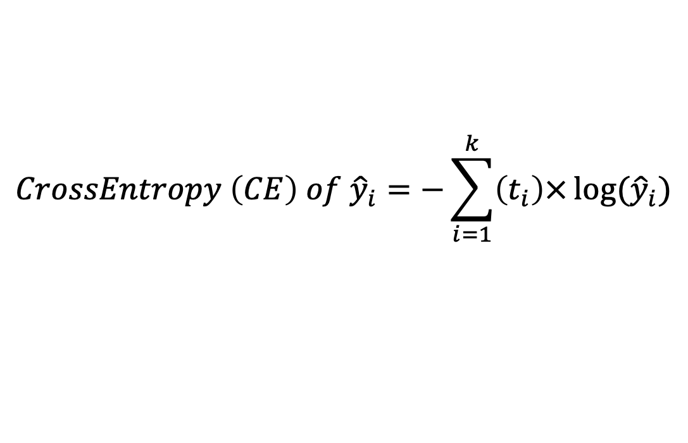
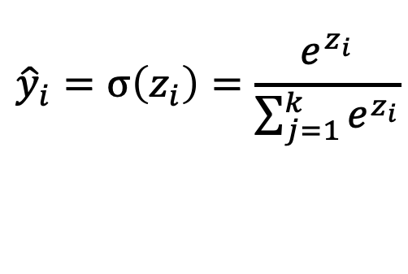
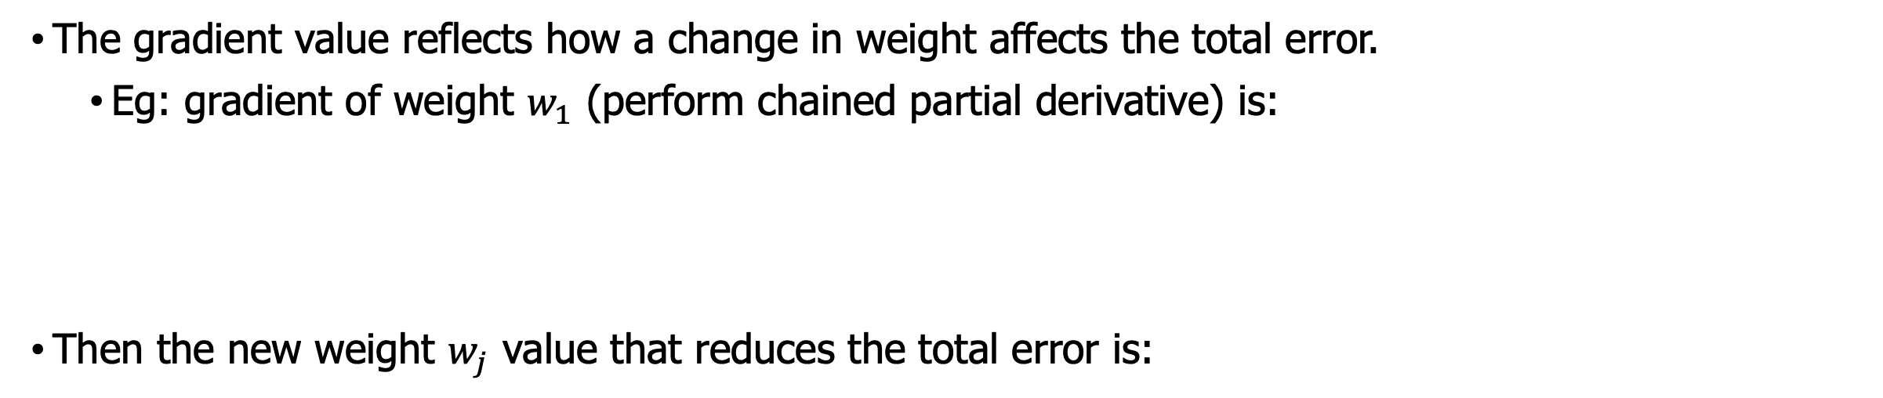
An Exploration in Object Detection and Application in Autonomous Vehicle
Duc Dao | Mathematics & Computer Science | Advised by Rob Kelvey & Max Taylor
Introduction
Fully Connected Layer (Forward Pass – Make a Guess)
nuImages Dataset
This study aims to assess the effectiveness of object detection models in autonomous vehicles. The main requirement for autonomous vehicles is to detect and avoid obstacles while adhering to traffic regulations. This study focuses on evaluating how well the autonomous vehicle can identify and classify obstacles. Two commonly used object detection models, Faster Region-based Convolutional Neural Network (Faster R-CNN) and You Only Look Once version 5 (YOLOv5), are examined. The study begins with a discussion of various computer vision tasks, followed by an overview of the structure of Mask R-CNN (a model that adds instance segmentation capabilities to Faster R-CNN) and YOLOv5. Finally, a comparison of Mask R-CNN and YOLOv5's effectiveness in detecting objects in traffic scenes from the nuImage dataset is conducted.
Neuron’s value in a forward pass (making a guess):
Convert output neuron’s value to probability (e.g., softmax function):
where $k$ is the number of classes, $z_{i}$ is the neuron’s value of class $i$.
Network’s error in predicting class $i$:
Total Error (or Total Cross-Entropy) of the network is the sum of errors across all classes.
Goal: Reduce total error to the global minimum. Note that this total error is for the classification task (classification loss).
A dataset that contain 93,000 images on traffic scenes
$$a_{j}=max⁡(0, a_{j} netin)=max\left(0, \sum_{i=1}^{n}{x_{i}w_{i,j}}+1(w_{0,j})\right)$$
$${\hat{y}}_{i}=σ\left(z_{i}\right)=\frac{e^{z_{i}}}{\sum_{j=1}^{k}{e^{z_{i}}}}$$
Different Computer Vision Tasks
$$CrossEntropy \left(CE\right) of {\hat{y}}_{i}=−\sum_{i=1}^{k}{\left(t_{i}\right)×}log⁡({\hat{y}}_{i})$$
Metrics
Object’s location correctness: $IoU= \frac{Area({BB}_{predict} ∩ {BB}_{truth})}{Area({BB}_{predict} ∪ {BB}_{truth})}$ (higher $IoU⇒$ better overlap)
Confidence score: the level of confidence that the model is in a prediction
Correct labeling: the model predicted label matches the ground truth label for an object
At each $IoU$ and confidence threshold, a confusion matrix is created based on label correctness
With confusion matrix, precision and recall are computed.
Precision: reflects the model correctness in classifying samples as belonging to a class
Recall: reflects the model's ability to identify all object instances of a class
With precision and recall, N-point interpolation Average Precision ($AP_{N}$) is computed
$AP_{N}$: An approximation of model’s performance in predicting a class across all confidence scores
Formula:
Then mean N-point interpolation Average Precision ($mAP_{N}$) denote model’s performance in predicting object of any class across all confidence scores at a given $IoU$ threshold
Formula: where $K$ is the number of supported class
Fully Connected Layer (Backward Pass – Learning)
Convolutional Neural Network (CNN)
Both Mask R-CNN and YOLOv5 is based on a CNN architecture
The CNN design for classification tasks comprises two main components:
Convolutional and pooling layers that perform feature extraction.
Fully connected layers that handle classification.
The gradient value reflects how a change in weight affects the total error.
Eg: gradient of weight $w_{1}$ (perform chained partial derivative) is:
Then the new weight $w_{j}$ value that reduces the total error is:
Result
$$new w_{j}=current w_{j} −\frac{Δ Tot. CE}{Δw_{j}}$$
Mask R-CNN
Conclusion
Convolutional & Pooling Layer
The result shows that YOLOv5 outperforms Mask R-CNN as an object detection model for autonomous vehicles since it can accurately detect objects at their correct locations
However, the results also reveal that neither model is fully prepared for deployment in real-world scenarios, as their performance rating falls below 60%
The performance of these models is evaluated using their pretrained weights, which may not fully reflect their potential in traffic detection applications. Therefore, additional domain-specific training is necessary to gain a better understanding of their performance
The convolutional layer uses a kernel to slide through an image and extract a feature. The kernel can be predefined to extract out vertical edge, horizontal edge, burying, sharpening, or can be learned by the network.
YOLOv5
Acknowledgment
YOLOv5 architecture is heavily based on the YOLOv3 architecture.
Since there is no research paper on YOLOv5, we analyze the YOLOv3 architecture instead.
I would like to thank my advisors, Rob Kelvey and Max Taylor, for their guidance, and the College of Wooster’s Mathematical and Computational Science Department for their support during this project.
References
Tedrake, R. (n.d.). Robotic manipulation. Ch. 9 - Object Detection and Segmentation. Retrieved April 6, 2023, from https://manipulation.csail.mit.edu/segmentation.html
Shah, S. (2022, March 15). Convolutional Neural Network: An overview. Analytics Vidhya. Retrieved April 6, 2023, from https://www.analyticsvidhya.com/blog/2022/01/convolutional-neural-network-an-overview/
3Blue1Brown. (2022, November 18). But what is a convolution? YouTube. Retrieved April 6, 2023, from https://www.youtube.com/watch?v=KuXjwB4LzSA&amp;t=1184s&amp;ab_channel=3Blue1Brown
Gad, A. F. (2021, April 9). Implementing gradient descent in Python, part 2: Extending for any number of inputs. Paperspace Blog. Retrieved April 6, 2023, from https://blog.paperspace.com/part-2-generic-python-implementation-of-gradient-descent-for-nn-optimization/
Taylor, M. (2017). Neural Networks: A visual introduction for beginners. Blue Windmill Media.
Gonzalez, S., Arellano, C., & Tapia, J. E. (2019). Deepblueberry: Quantification of blueberries in the wild using instance segmentation. Ieee Access, 7, 105776-105788.
Datahacker.rs. (2020, March 17). #011 TF Yolo V3 object detection in tensorflow 2.0. Master Data Science. Retrieved April 6, 2023, from https://datahacker.rs/tensorflow2-0-yolov3/
Vertical edge extraction kernel
The output of the convolutional layer is a feature map. If extracting multiple features, then the resulting feature maps will be stacked along the depth dimension.
Consider each pixel inside the feature map as a neuron ⇒ a large number of neurons (some might not be necessary) ⇒ pooling layer is used to reduce the number of pixels inside the feature map.
Each pixel in extracted feature maps is an entry in the input vector (flatten operation) for FCs.

Slide 2
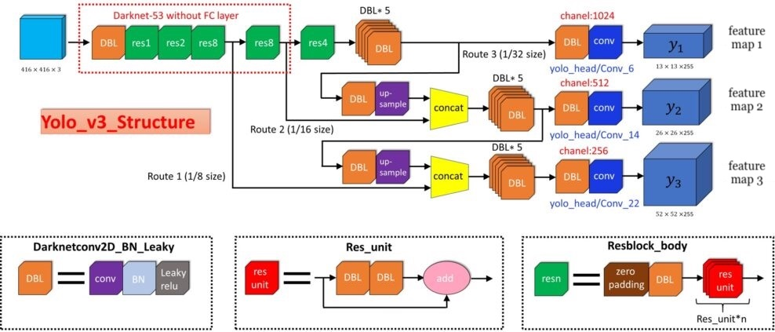
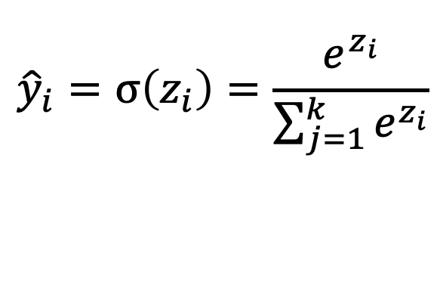
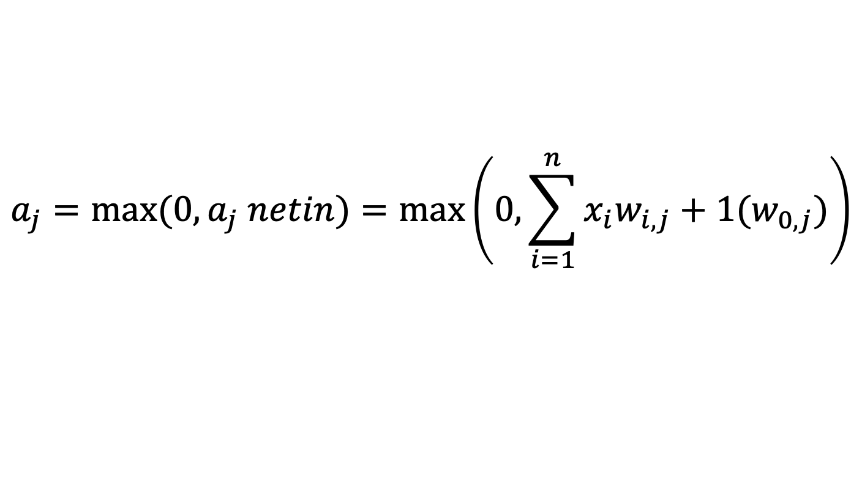
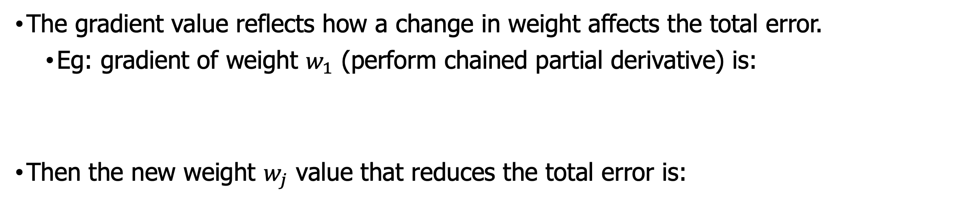
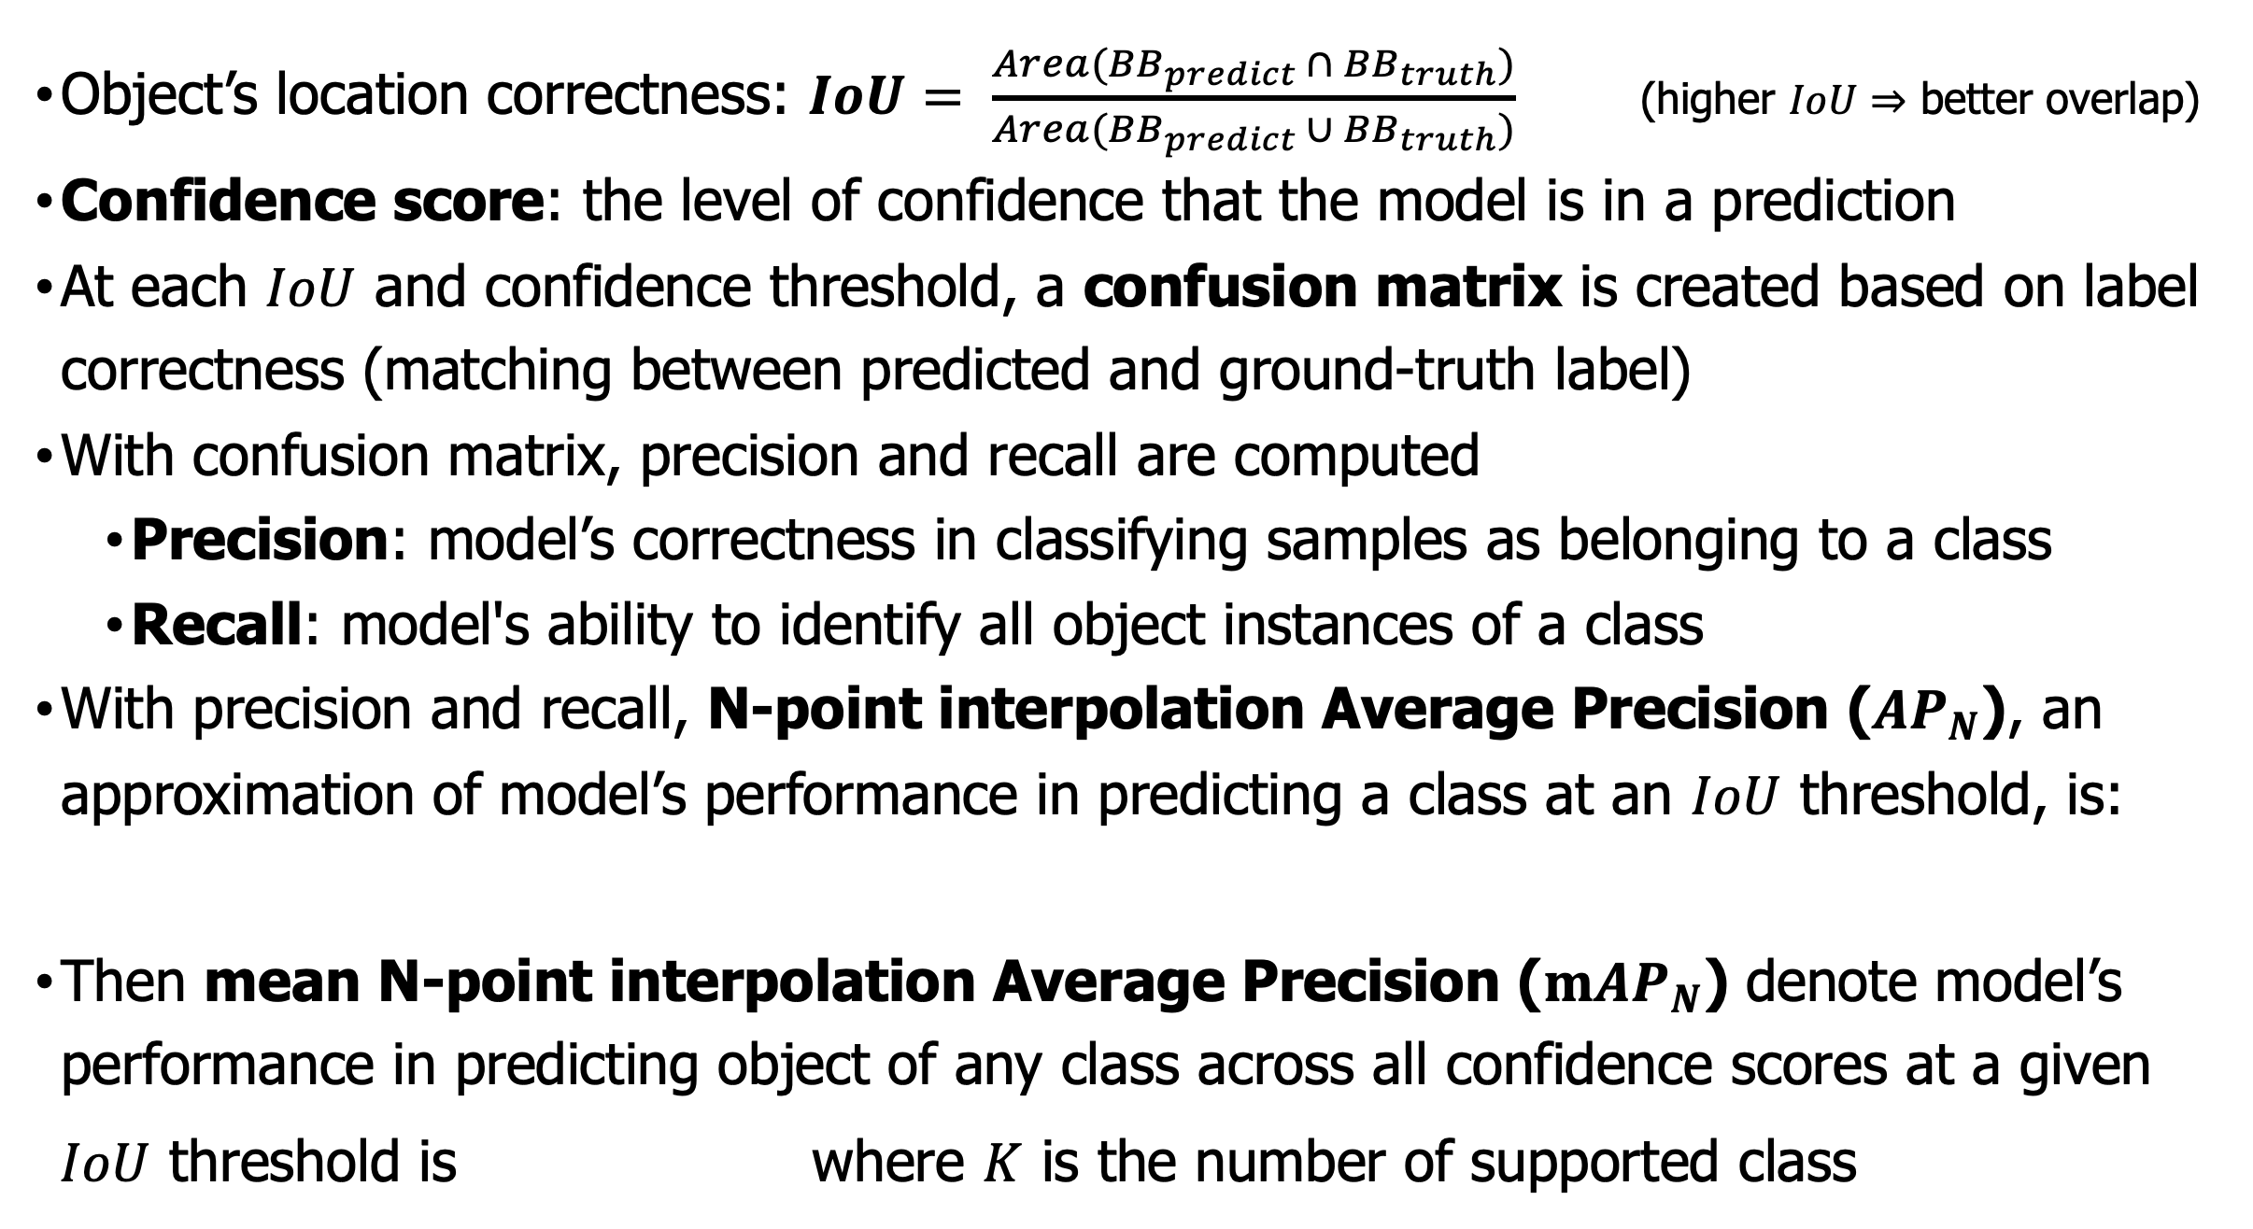
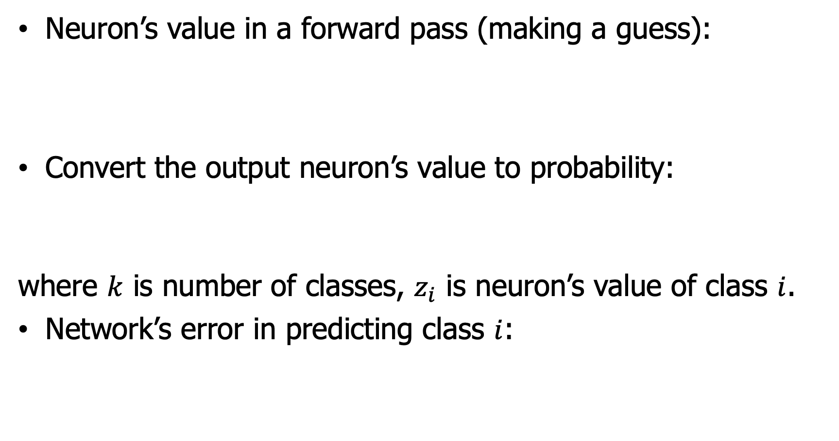
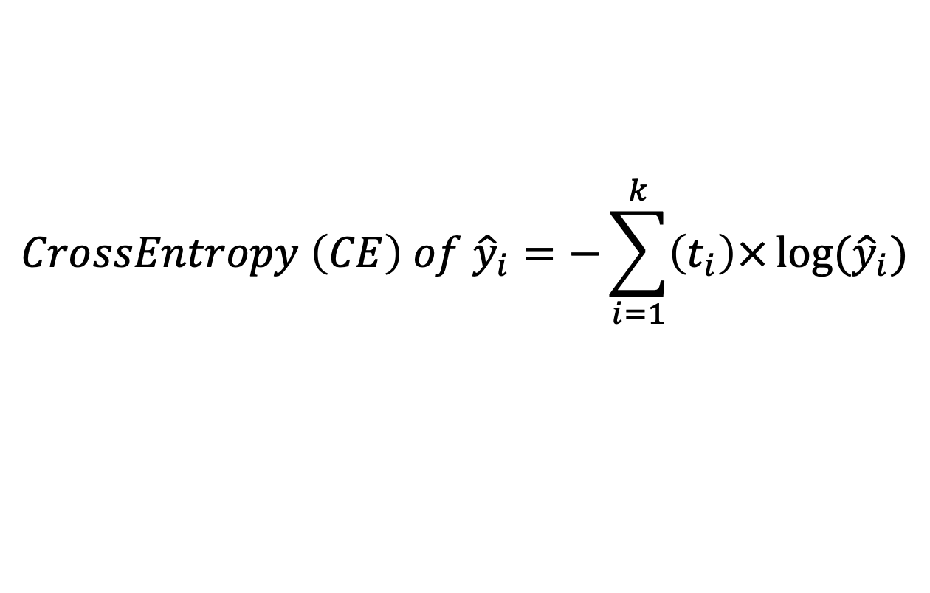
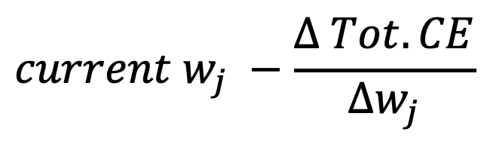
An Exploration in Object Detection and Application in Autonomous Vehicle
Duc Dao | Mathematics & Computer Science | Advised by Rob Kelvey & Max Taylor
Introduction
Fully Connected Layer (Forward Pass – Make a Guess)
nuImages Dataset
This study aims to assess the effectiveness of object detection models in autonomous vehicles. This study focuses on evaluating how well the autonomous vehicle can identify and classify obstacles. Two commonly used object detection models, Faster Region-based Convolutional Neural Network (Faster R-CNN) and You Only Look Once version 5 (YOLOv5), are examined. The study begins with a discussion of various computer vision tasks, followed by an overview of the structure of Mask R-CNN (a model that adds instance segmentation capabilities to Faster R-CNN) and YOLOv5. Finally, a comparison of Mask R-CNN and YOLOv5's effectiveness in detecting objects in traffic scenes from the nuImage dataset is conducted.
Neuron’s value in a forward pass (making a guess):
Convert the output neuron’s value to probability:
where $k$ is number of classes, $z_{i}$ is neuron’s value of class $i$.
Network’s error in predicting class $i$:
[4]
A dataset that contain 93,000 images on traffic scenes
$$a_{j}=max⁡(0, a_{j} netin)=max\left(0, \sum_{i=1}^{n}{x_{i}w_{i,j}}+1(w_{0,j})\right)$$
$${\hat{y}}_{i}=σ\left(z_{i}\right)=\frac{e^{z_{i}}}{\sum_{j=1}^{k}{e^{z_{i}}}}$$
$$CrossEntropy \left(CE\right) of {\hat{y}}_{i}=−\sum_{i=1}^{k}{\left(t_{i}\right)×}log⁡({\hat{y}}_{i})$$
Metrics
Different Computer Vision Tasks
Object’s location correctness: $IoU= \frac{Area({BB}_{predict} ∩ {BB}_{truth})}{Area({BB}_{predict} ∪ {BB}_{truth})}$ (higher $IoU⇒$ better overlap)
Confidence score: the level of confidence that the model is in a prediction
At each $IoU$ and confidence threshold, a confusion matrix is created based on label correctness (matching between predicted and ground-truth label)
With confusion matrix, precision and recall are computed
Precision: model’s correctness in classifying samples as belonging to a class
Recall: model's ability to identify all object instances of a class
With precision and recall, N-point interpolation Average Precision ($AP_{N}$), an approximation of model’s performance in predicting a class at an $IoU$ threshold, is:
Then mean N-point interpolation Average Precision ($mAP_{N}$) denote model’s performance in predicting object of any class across all confidence scores at a given
$IoU$ threshold is where $K$ is the number of supported class
[1]
Network’s Total Error (or Total Cross-Entropy) is the sum of all classes’ errors.
Goal: Reduce total error to minimum.
Fully Connected Layer (Backward Pass – Learning)
[4]
Convolutional Neural Network (CNN)
The gradient value reflects how a change in weight affects the total error.
Eg: gradient of weight $w_{1}$ (perform chained partial derivative) is:
Then the new weight $w_{j}$ value that reduces the total error is:
Both Mask R-CNN and YOLOv5 is based on a CNN architecture
Result
[2]
$$current w_{j} −\frac{Δ Tot. CE}{Δw_{j}}$$
Mask R-CNN
[5]
Convolutional & Pooling Layer
Conclusion
The convolutional layer: slide kernel(s) through an image to extract features.
The kernel can be predefined to extract out vertical edge, horizontal edge, burying, sharpening, or can be learned by the network.
The result shows that YOLOv5 outperforms Mask R-CNN as an object detection model for autonomous vehicles as it can accurately detect objects at their correct locations
However, the results also reveal that neither model is fully prepared for deployment in real-world scenarios, as their performance rating falls below 60%
The performance of these models is evaluated using their pretrained weights, which may not fully reflect their potential in traffic detection applications. Thus, additional domain training is necessary to gain better understanding of their performance
[3]
YOLOv5
YOLOv5 architecture is heavily based on the YOLOv3 architecture.
Acknowledgment
[6]
I would like to thank my advisors, Rob Kelvey and Max Taylor, for their guidance, and the College of Wooster’s Mathematical and Computational Science Department for their support during this project.
References
Vertical edge extraction kernel
[1] Tedrake, R. (n.d.). Robotic manipulation. Ch. 9 - Object Detection and Segmentation. Retrieved April 6, 2023, from https://manipulation.csail.mit.edu/segmentation.html
[2] Shah, S. (2022, March 15). Convolutional Neural Network: An overview. Analytics Vidhya. Retrieved April 6, 2023, from https://www.analyticsvidhya.com/blog/2022/01/convolutional-neural-network-an-overview/
[3] 3Blue1Brown. (2022, November 18). But what is a convolution? YouTube. Retrieved April 6, 2023, from https://www.youtube.com/watch?v=KuXjwB4LzSA&amp;t=1184s&amp;ab_channel=3Blue1Brown
[4] Taylor, M. (2017). Neural Networks: A visual introduction for beginners. Blue Windmill Media.
[5] Gonzalez, S., Arellano, C., & Tapia, J. E. (2019). Deepblueberry: Quantification of blueberries in the wild using instance segmentation. Ieee Access, 7, 105776-105788.
[6] Datahacker.rs. (2020, March 17). #011 TF Yolo V3 object detection in tensorflow 2.0. Master Data Science. Retrieved April 6, 2023, from https://datahacker.rs/tensorflow2-0-yolov3/
The output of the convolutional layer is a feature map.
Extracting multiple features result in stacked feature maps along the depth dimension.
Pooling layer is used to reduce the number of pixels inside the feature map.
Each pixel in extracted feature maps is an entry in the input vector (flatten operation) for FCs.

Slide 3
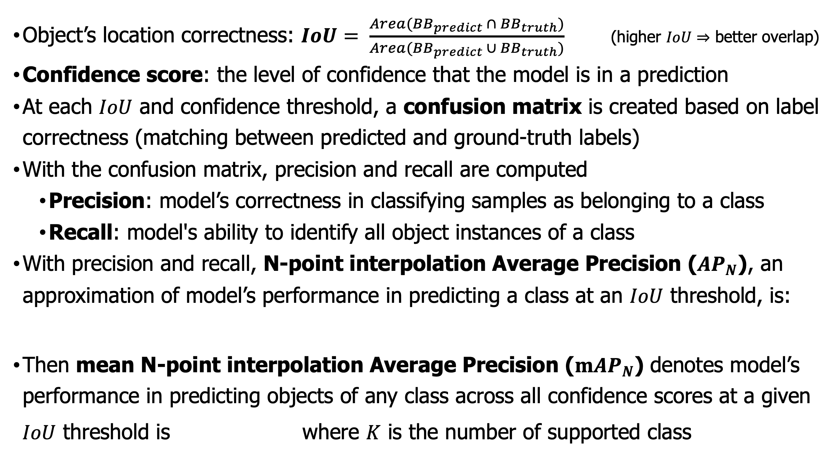
An Exploration in Object Detection and Application in Autonomous Vehicle
Duc Dao | Mathematics & Computer Science | Advised by Rob Kelvey & Max Taylor
Introduction
Fully Connected Layer (Forward Pass – Make a Guess)
nuImages Dataset
This study aims to assess the effectiveness of object detection models in autonomous vehicles. This study evaluates how well the autonomous vehicle can identify and classify obstacles. Two commonly used object detection models, Faster Region-based Convolutional Neural Network (Faster R-CNN) and You Only Look Once version 5 (YOLOv5), are examined. The study begins with a discussion of various computer vision tasks, followed by an overview of the structure of Mask R-CNN (a model that adds instance segmentation capabilities to Faster R-CNN) and YOLOv5. Finally, a comparison of Mask R-CNN and YOLOv5's effectiveness in detecting objects in traffic scenes from the nuImage dataset is conducted.
Neuron’s value in a forward pass (making a guess):
Convert the output neuron’s value to probability:
where $k$ is number of classes, $z_{i}$ is neuron’s value of class $i$.
Network’s error in predicting class $i$:
[4]
A dataset that contain 93,000 images on traffic scenes
$$a_{j}=max⁡(0, a_{j} netin)=max\left(0, \sum_{i=1}^{n}{x_{i}w_{i,j}}+1(w_{0,j})\right)$$
$${\hat{y}}_{i}=σ\left(z_{i}\right)=\frac{e^{z_{i}}}{\sum_{j=1}^{k}{e^{z_{i}}}}$$
$$CrossEntropy \left(CE\right) of {\hat{y}}_{i}=−\sum_{i=1}^{k}{\left(t_{i}\right)×}log⁡({\hat{y}}_{i})$$
Metrics
Different Computer Vision Tasks
Object’s location correctness: $IoU= \frac{Area({BB}_{predict} ∩ {BB}_{truth})}{Area({BB}_{predict} ∪ {BB}_{truth})}$ (higher $IoU⇒$ better overlap)
Confidence score: the level of confidence that the model is in a prediction
At each $IoU$ and confidence threshold, a confusion matrix is created based on label correctness (matching between predicted and ground-truth labels)
With the confusion matrix, precision and recall are computed
Precision: model’s correctness in classifying samples as belonging to a class
Recall: model's ability to identify all object instances of a class
With precision and recall, N-point interpolation Average Precision ($AP_{N}$), an approximation of model’s performance in predicting a class at an $IoU$ threshold, is:
Then mean N-point interpolation Average Precision ($mAP_{N}$) denotes model’s performance in predicting objects of any class across all confidence scores at a given
$IoU$ threshold is where $K$ is the number of supported class
[1]
Network’s Total Error (or Total Cross-Entropy) is the sum of all classes’ errors.
Goal: Reduce total error to minimum.
Fully Connected Layer (Backward Pass – Learning)
[4]
Convolutional Neural Network (CNN)
The gradient value reflects how a change in weight affects the total error.
Eg: gradient of weight $w_{1}$ (perform chained partial derivative) is:
Then the new weight $w_{j}$ value that reduces the total error is:
Both Mask R-CNN and YOLOv5 are based on a CNN architecture
Result
[2]
$$current w_{j} −\frac{Δ Tot. CE}{Δw_{j}}$$
Mask R-CNN
[5]
Convolutional & Pooling Layer
Conclusion
The convolutional layer: slide kernel(s) through an image to extract features.
The kernel can be predefined to extract out vertical edge, horizontal edge, burying, sharpening, or can be learned by the network.
The result shows that YOLOv5 outperforms Mask R-CNN as an object detection model for autonomous vehicles as it can accurately detect objects at their correct locations
However, the results also reveal that neither model is fully prepared for deployment in real-world scenarios, as their performance rating falls below 60%
The performance of these models is evaluated using their pretrained weights, which may not fully reflect their potential in traffic detection applications. Thus, additional domain training is necessary to gain a better understanding of their performance
[3]
YOLOv5
YOLOv5 architecture is heavily based on the YOLOv3 architecture.
Acknowledgment
[6]
I would like to thank my advisors, Rob Kelvey and Max Taylor, for their guidance, and the College of Wooster’s Mathematical and Computational Science Department for their support during this project.
Vertical edge extraction kernel
References
The output of the convolutional layer is a feature map.
Extracting multiple features results in stacked feature maps along the depth dimension.
Pooling layer is used to reduce the number of pixels inside the feature map.
Each pixel in extracted feature maps is an entry in the input vector (flatten operation) for FCs.
[1] Tedrake, R. (n.d.). Robotic manipulation. Ch. 9 - Object Detection and Segmentation. Retrieved April 6, 2023, from https://manipulation.csail.mit.edu/segmentation.html
[2] Shah, S. (2022, March 15). Convolutional Neural Network: An overview. Analytics Vidhya. Retrieved April 6, 2023, from https://www.analyticsvidhya.com/blog/2022/01/convolutional-neural-network-an-overview/
[3] 3Blue1Brown. (2022, November 18). But what is a convolution? YouTube. Retrieved April 6, 2023, from https://www.youtube.com/watch?v=KuXjwB4LzSA&amp;t=1184s&amp;ab_channel=3Blue1Brown
[4] Taylor, M. (2017). Neural Networks: A visual introduction for beginners. Blue Windmill Media.
[5] Gonzalez, S., Arellano, C., & Tapia, J. E. (2019). Deepblueberry: Quantification of blueberries in the wild using instance segmentation. Ieee Access, 7, 105776-105788.
[6] Datahacker.rs. (2020, March 17). #011 TF Yolo V3 object detection in tensorflow 2.0. Master Data Science. Retrieved April 6, 2023, from https://datahacker.rs/tensorflow2-0-yolov3/

